Slide 1

MTP Phase II Seminar
A Comprehensive Multimodal Approach for Detecting Malpractice in Online Exams
YETURI VENKATESH
Roll No. 224102324
M.Tech. Signal Processing and Machine Learning
Supervisor:
Dr. Anirban Dasgupta
Assistant Professor
Dept. of Electronics and Electrical Engineering
Indian Institute of Technology Guwahati

Slide 2
Presentation Outline
Problem Statement
Prior Art
Impersonation
External Assistance
Data Collection
Overall Architecture
Conclusion
Limitations and Future Scope

Slide 3
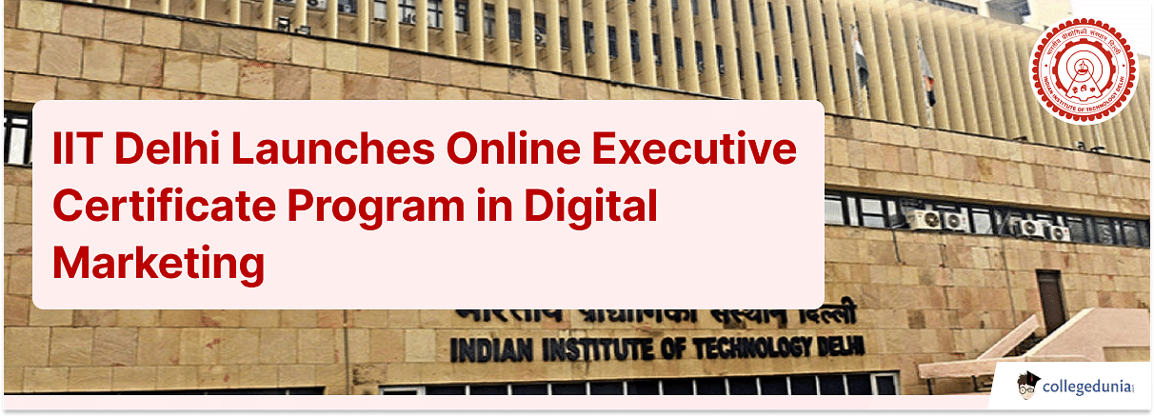
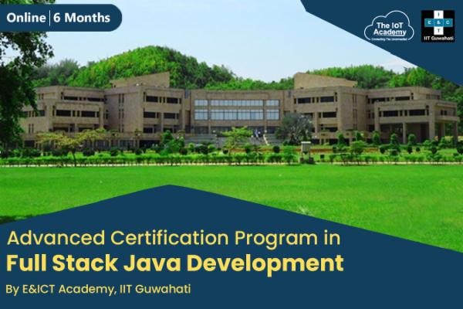

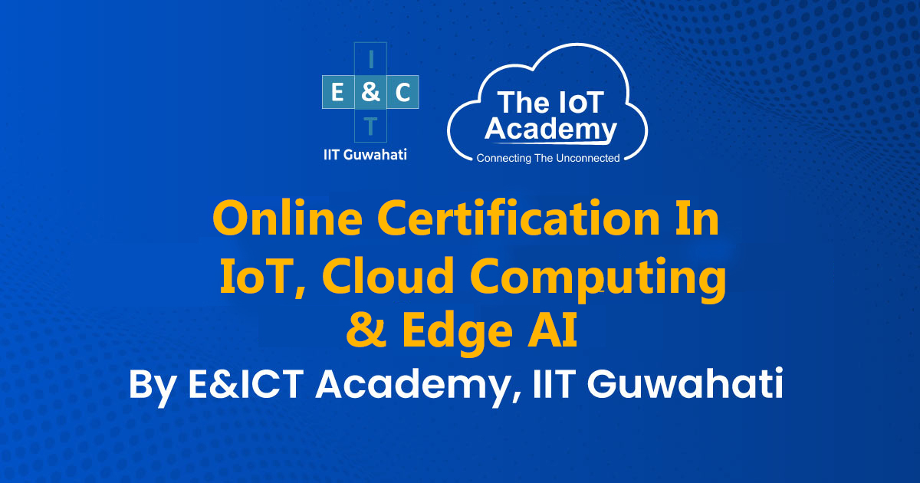
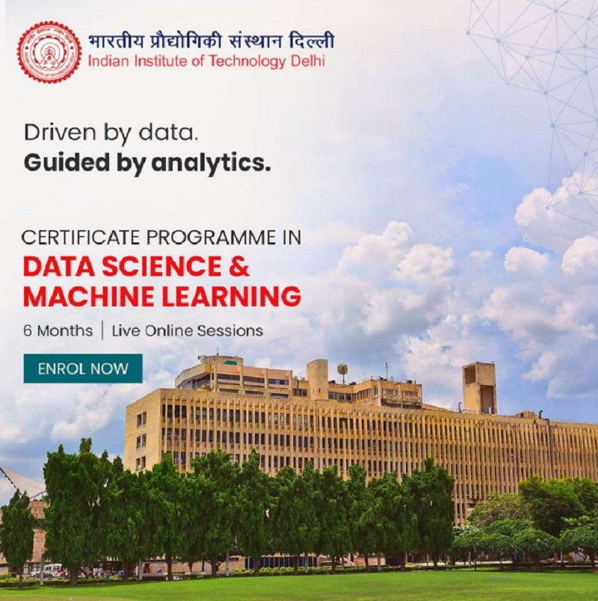

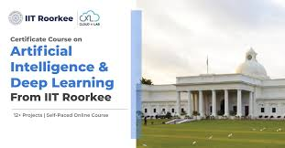
Introduction
Yeturi Venkatesh, 224102324
Notes:
Online education has revolutionized the education market especially after introducing the platforms like Coursera, Udacity and NPTEL…
The effect of COVID-19 has caused many institutions to switch their medium of delivering lectures from in-person to online mode following public safety regulations.
Automatically the mode of exams is also completely changed according to the mode of instructions.

Slide 4
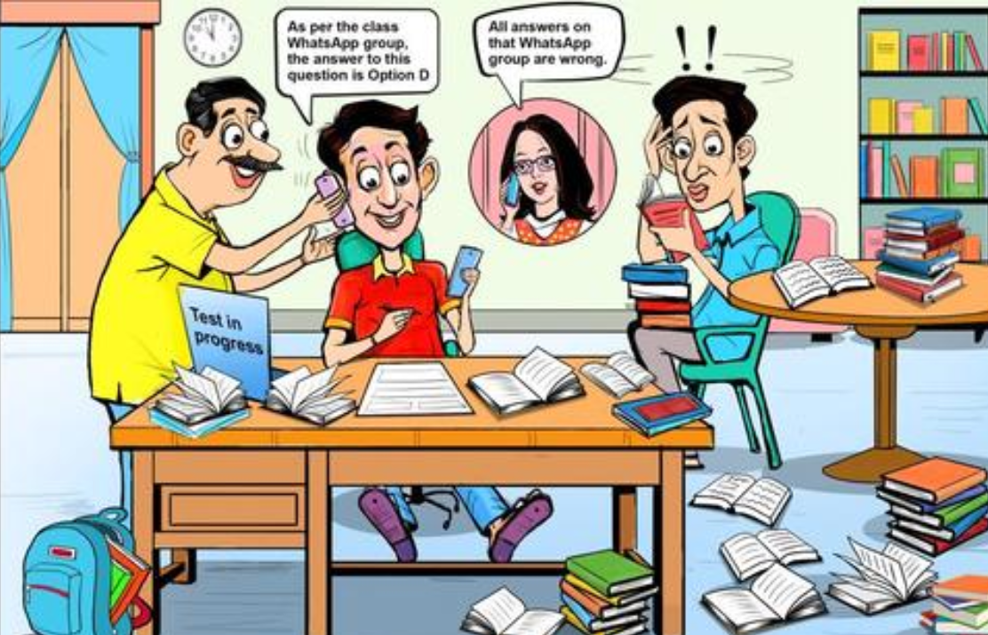
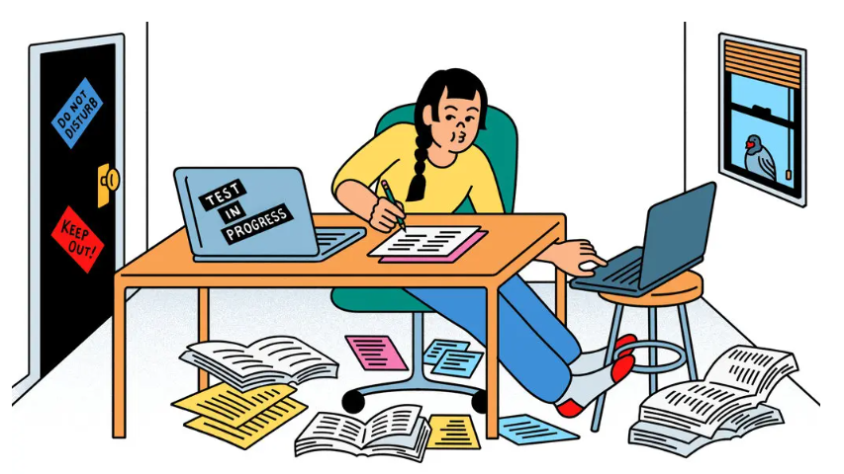
Problem Statement
Problem Definition
Developing a system for detecting malpractice in online exams.
Prior Art
Impersonation
External Assistance
Data Collection
Overall Architecture
Conclusion
Limitations and Future Scope
Yeturi Venkatesh, 224102324
Notes:
The need of malpractice detection systems also has been increased.
The students may involve different types of malpractice aiming at scoring good grades
Explain both the pictures.
Need of this system to ensure exam integrity

Slide 5
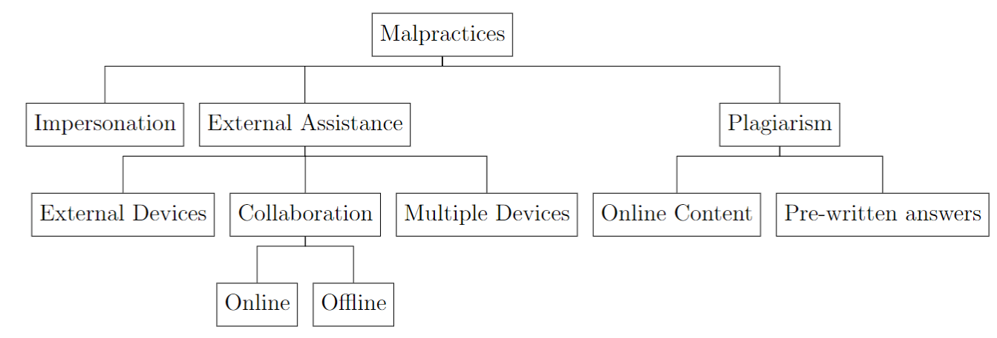
Problem Statement
Problem Definition
Types of Malpractices
Prior Art
Impersonation
External Assistance
Data Collection
Overall Architecture
Conclusion
Limitations and Future Scope
Yeturi Venkatesh, 224102324
Notes:
From the literature survey and various web sources, these are the types of malpractices.
Explain each type clearly
Mainly first two are focused things in my research and plagiarism, there are already enough no.of software available like Turnitin, Grammarly and all
AI generated check is also available

Slide 6
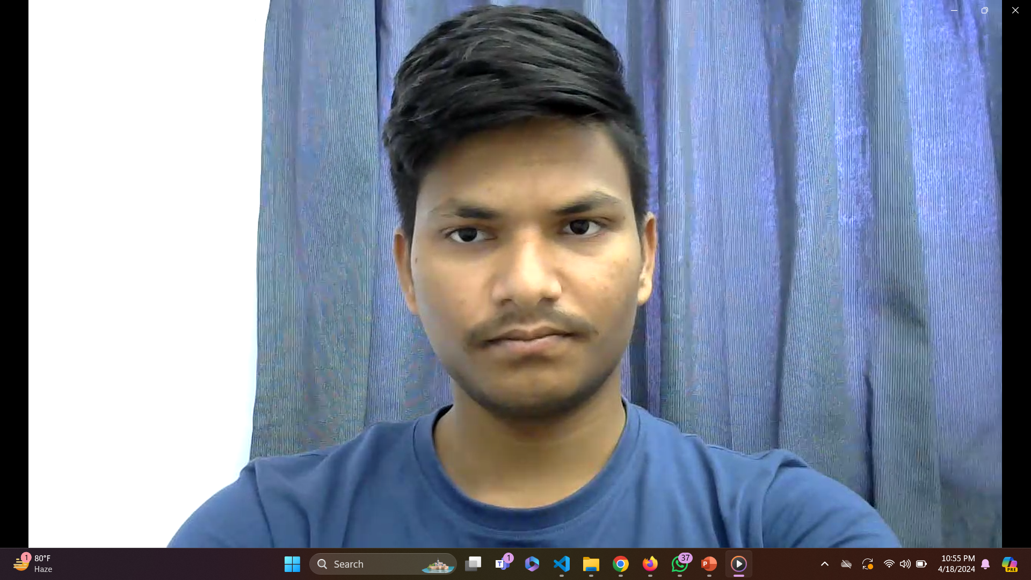
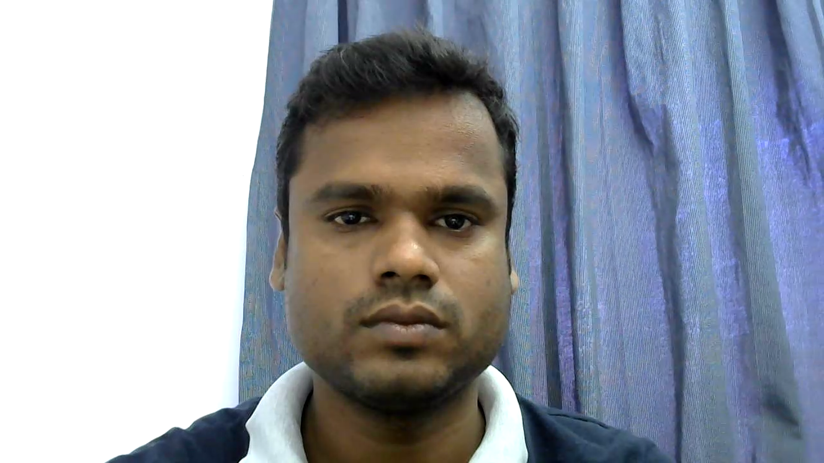
Impersonation
Problem Definition
Prior Art
Impersonation
External Assistance
Data Collection
Overall Architecture
Examinee Details:
Name : Yeturi Venkatesh
Roll No. 224102324
Exam : EE 390
Examinee Details:
Name : Yeturi Venkatesh
Roll No. 224102324
Exam : EE 390
Conclusion
Limitations and Future Scope
Yeturi Venkatesh, 224102324
Notes:
From the literature survey and various web sources, these are the types of malpractices.
Explain each type clearly
Mainly first two are focused things in my research and plagiarism, there are already enough no.of software available like Turnitin, Grammarly and all
AI generated check is also available

Slide 7
External Assistance
Problem Definition
Using External Sources
Collaboration
(online & offline)
Multiple login devices
Prior Art
Impersonation
External Assistance
Referring to mobile phones, tabs, books or other material
Head pose and Eye gaze are extracted to detect this kind of activity
Offline: Discussing with the people present in the room away from the camera
Sequences of Mouth state along with head pose and eye gaze are to be extracted to detect this kind of activity
Software can be implemented to detect multiple logins observing MAC ID information
Data Collection
Overall Architecture
Conclusion
Limitations and Future Scope
Yeturi Venkatesh, 224102324
Notes:
From the literature survey and various web sources, these are the types of malpractices.
Explain each type clearly
Mainly first two are focused things in my research and plagiarism, there are already enough no.of software available like Turnitin, Grammarly and all
AI generated check is also available

Slide 8
Prior Art
Problem Definition
Impersonation Detection
External Assistance Detection
Prior Art
Liu et al. have worked on a fingerprint authentication system and transformed the verification process from verification of username and password to verification of examinee fingerprint.
Pooja et al. introduced two step biometric authentication which used fingerprint and face recognition using eigen faces.
Indi et al. proposed a system that captures eye gaze as the primary feature for malpractice detection, followed by head pose classification.
Two separate classification models are used for eye gaze and head pose classifications and achieved an accuracy of 96.04%.
Santhosh et al. worked on developing machine learning models for detecting laughter, eye gaze, and head pose.
Impersonation
External Assistance
Data Collection
Overall Architecture
Conclusion
Limitations and Future Scope
Yeturi Venkatesh, 224102324
Notes:
Indi et al. introduced the term VFOA (Visual Focus of Attention) out of which if the head of examinee moves X no.of times will be treated as malpractice.

Slide 9
Comparison of Authentication processes
Problem Definition
Fingerprint Authentication
Face Authentication
Prior Art
Each examinee requires a supplementary fingerprint scanning device for authentication
Intermittent verification poses disruptions to examinees and thus isn't recommended
Fingerprints can be affected by factors like moisture, dirt, and any injury to the fingers
Hygiene concerns as it may cause potential spread of germs
Achieves high accuracy effortlessly
Doesn't necessitate additional hardware
Intermittent verification is viable due to the constant presence of an active camera
User- friendly
Achieves high accuracy through sophisticated machine learning algorithms and high-resolution cameras.
Challenging when the examinee wears glasses or a mask and during poor light conditions
Impersonation
External Assistance
Data Collection
Overall Architecture
Conclusion
Limitations and Future Scope
Yeturi Venkatesh, 224102324

Slide 10
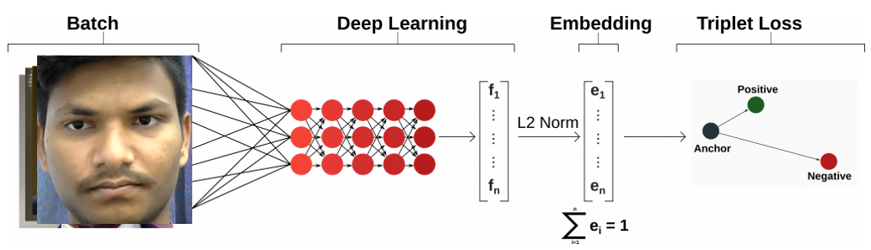
Working of FaceNet
Problem Definition
Prior Art
Impersonation
External Assistance
Data Collection
Overall Architecture
FaceNet is a facial recognition system developed by Google researchers in 2015.
It uses deep learning architectures like ZF-Net and Inception Network to generate a high-quality face mapping from images.
Conclusion
Limitations and Future Scope
Yeturi Venkatesh, 224102324
Notes:
FaceNet is introduced by Google researchers
It is

Slide 11
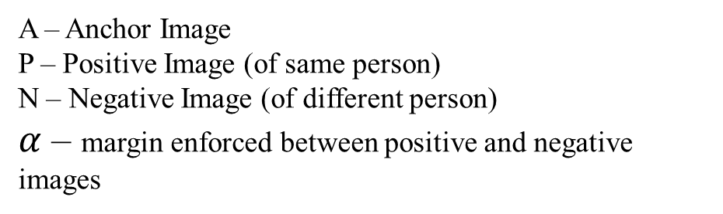

Working of FaceNet
Problem Definition
Prior Art
Triplet Loss:
Impersonation
External Assistance
Data Collection
$ℒ$ - Triplet Loss
A – Anchor Image
P – Positive Image (of same person)
N – Negative Image (of different person)
$α$ – margin enforced between positive and negative images
Overall Architecture
Conclusion
Limitations and Future Scope
Yeturi Venkatesh, 224102324

Slide 12
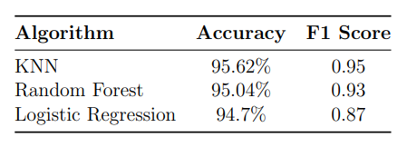
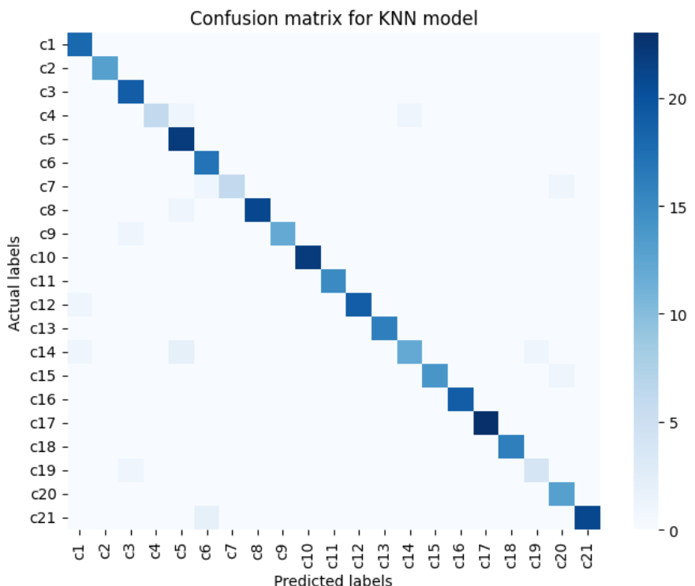
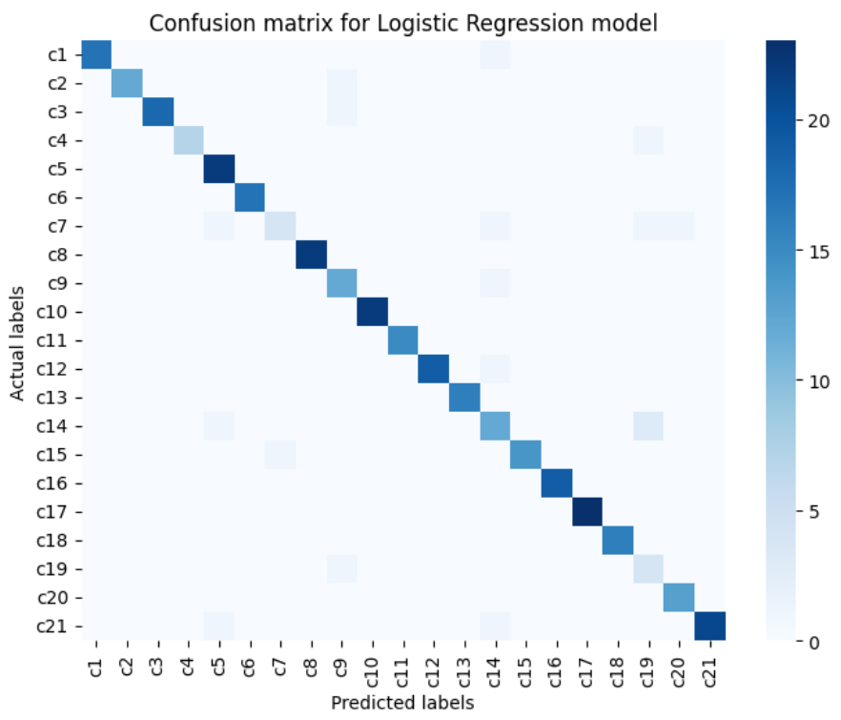
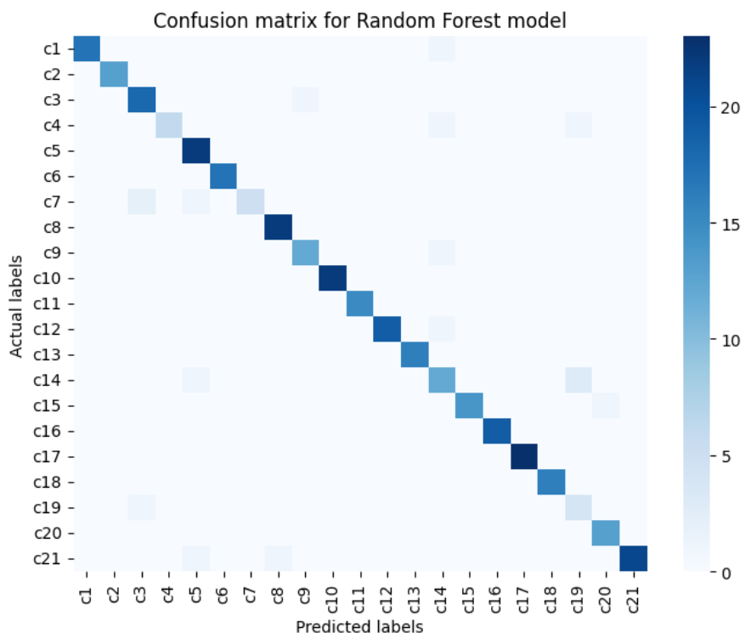
Impersonation Detection - Results
Problem Definition
Prior Art
Cn – nth candidate
Impersonation
External Assistance
Data Collection
Overall Architecture
Conclusion
Limitations and Future Scope
Yeturi Venkatesh, 224102324

Slide 13
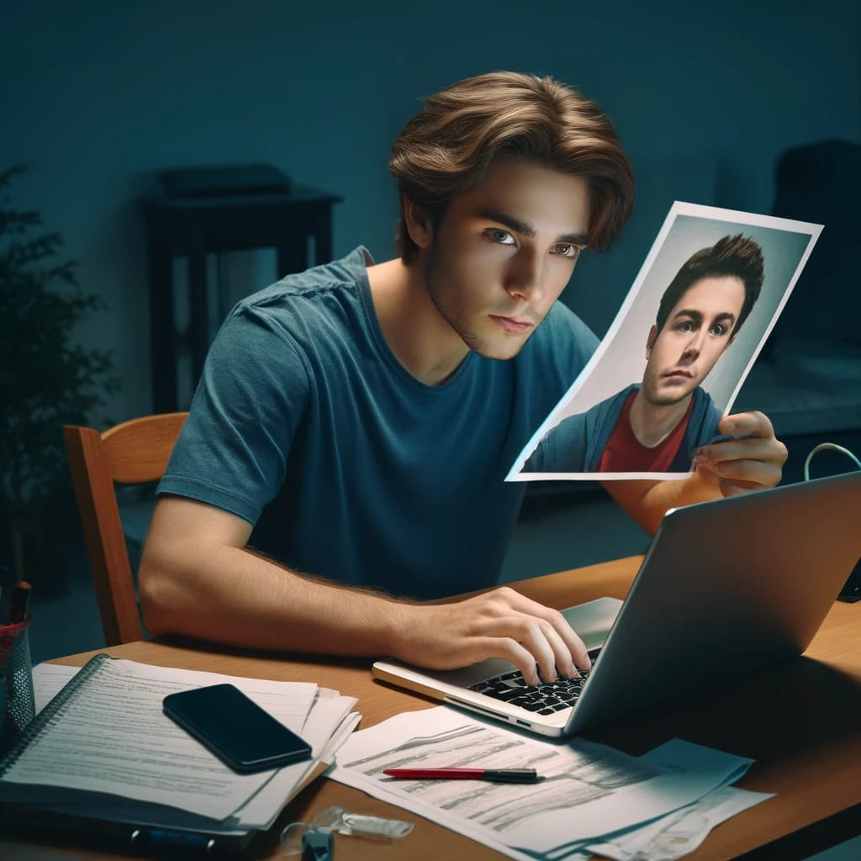
Challenge: Spoof attacking
Problem Definition
Prior Art
Spoofing techniques:
Utilizing 2D printouts of the candidate's genuine facial image for camera verification.
Displaying a digital representation of the candidate's face via an electronic device to deceive the camera system.
Wearing 3D masks crafted to closely resemble the actual candidate's facial features.
Impersonation
External Assistance
Data Collection
Overall Architecture
Conclusion
Src: AI-Generated
Limitations and Future Scope
Yeturi Venkatesh, 224102324

Slide 14
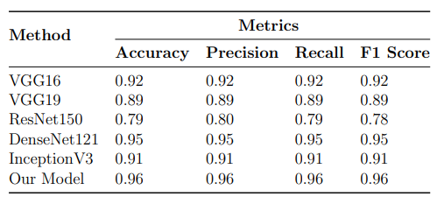
Solution: Face liveliness Detection using Deep learning
Problem Definition
Prompting candidates to perform specific actions like blinking or smiling to verify their liveliness
Problem: A binary classification problem to classify an image as real or spoof.
Prior Art
Impersonation
External Assistance
Data Collection
Overall Architecture
Conclusion
Limitations and Future Scope
Yeturi Venkatesh, 224102324

Slide 15
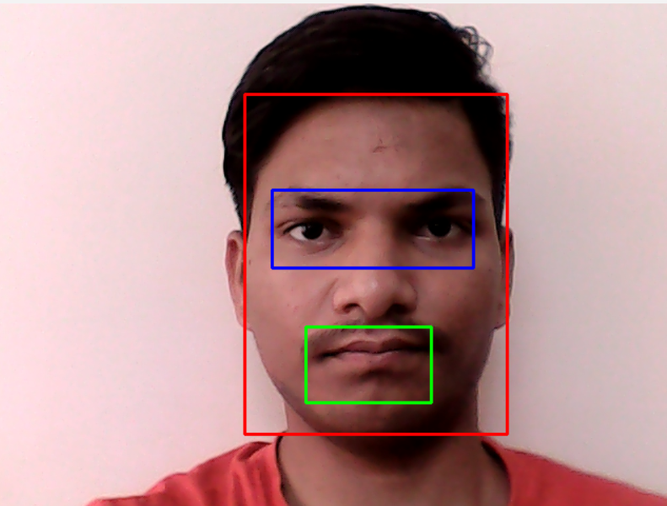
Face, Eye and Mouth Detection
Problem Definition
Prior Art
Haar cascade face
Impersonation
External Assistance
Haar cascade eye
Pre-trained models
Data Collection
Haar cascade mouth
Overall Architecture
Conclusion
Limitations and Future Scope
Yeturi Venkatesh, 224102324

Slide 16
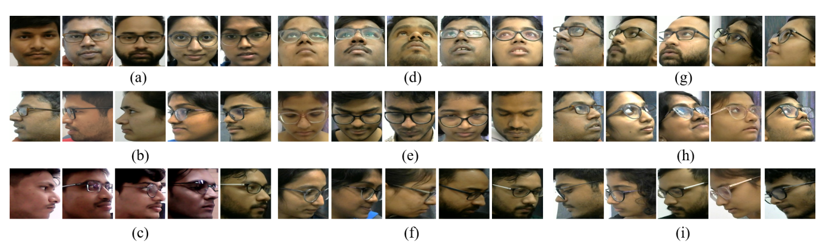
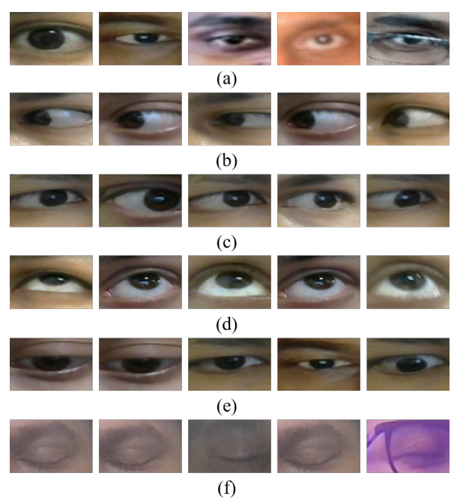
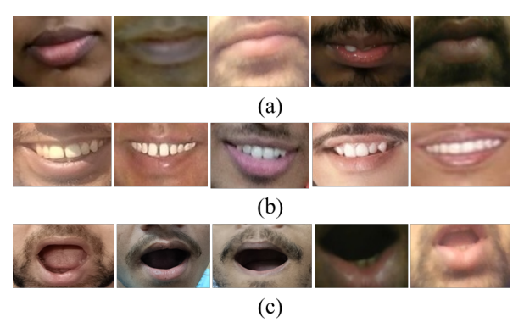
Data Collection
Problem Definition
Frontal
Up
Up left diagonal
Left
Down
Up right diagonal
Right
Down right diagonal
Down left diagonal
Prior Art
Impersonation
External Assistance
Data Collection
Frontal
Left
Right
Up
Down
Closed eyes
Closed
Open
Wide open
Overall Architecture
Conclusion
Fig: Subjects of head, eye, and mouth in different modes
Limitations and Future Scope
Yeturi Venkatesh, 224102324

Slide 17
Experiment Design
Problem Definition
Video data is collected for two scenarios, each lasting for 30 seconds.
Prior Art
Case 1: Maintaining Integrity
Case 2: Allowing malpractice
Implementing rigorous invigilation procedures.
Designing the question paper with a moderate difficulty level.
Installing surveillance cameras for monitoring.
Enforcing a strict no-electronic-devices policy in the examination hall.
Arranging seating arrangements to prevent communication between candidates.
Loosening invigilation measures intentionally.
Introducing highly challenging questions on the exam paper.
Omitting the installation of surveillance cameras.
Allowing electronic devices.
Allowing close proximity seating arrangements to encourage communication and collaboration among candidates.
Impersonation
External Assistance
Data Collection
Overall Architecture
Conclusion
Limitations and Future Scope
Yeturi Venkatesh, 224102324

Slide 18
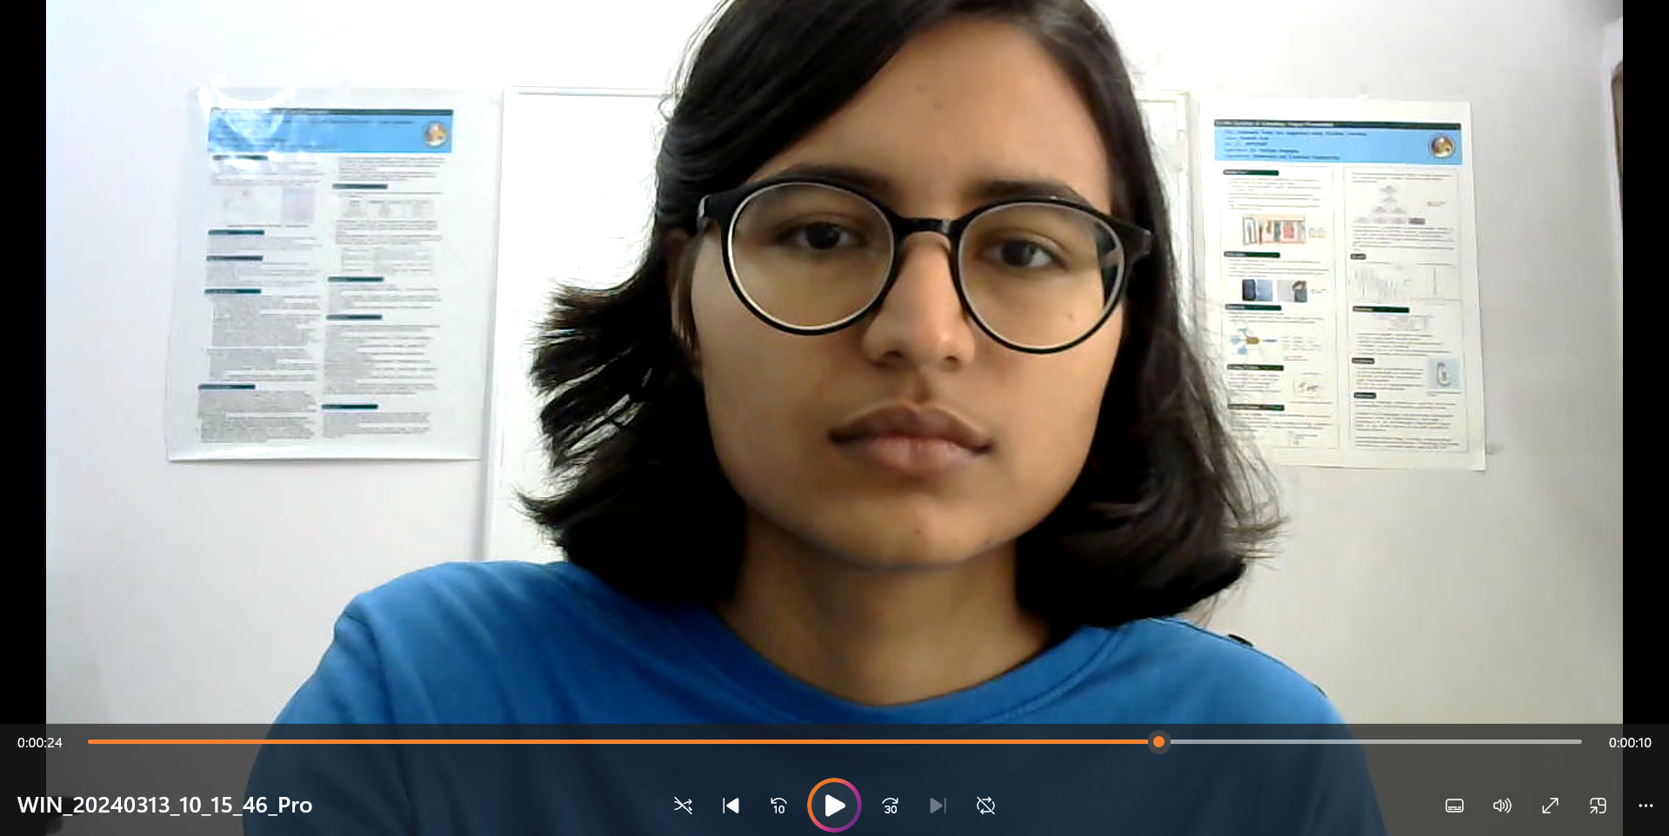
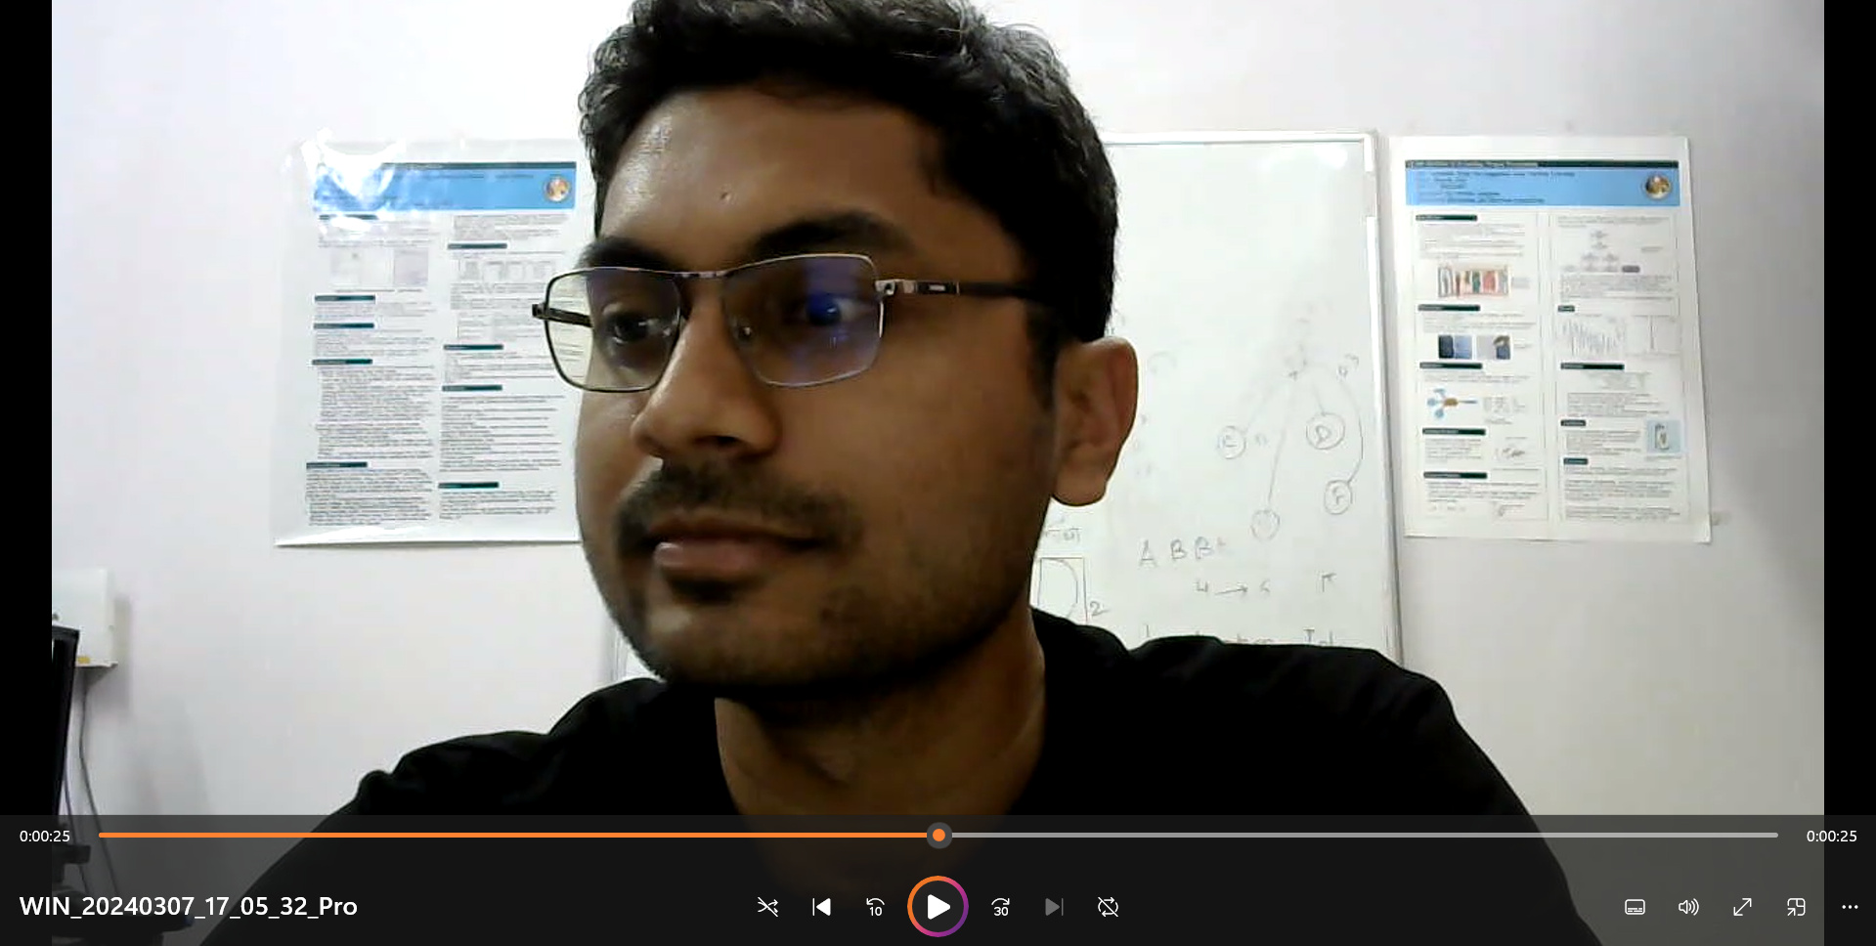
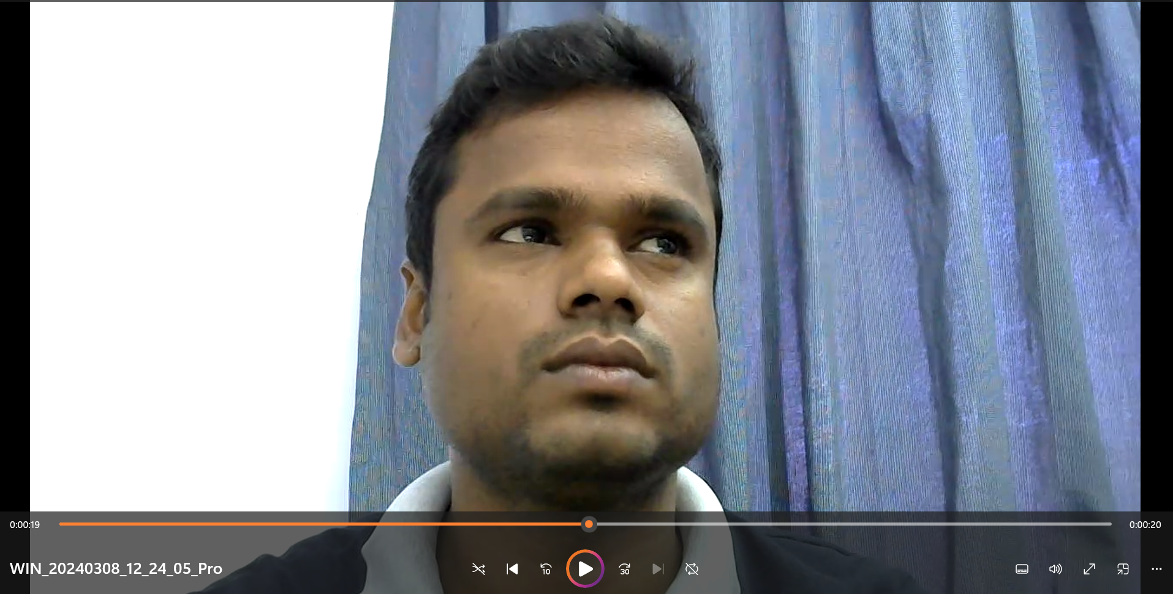
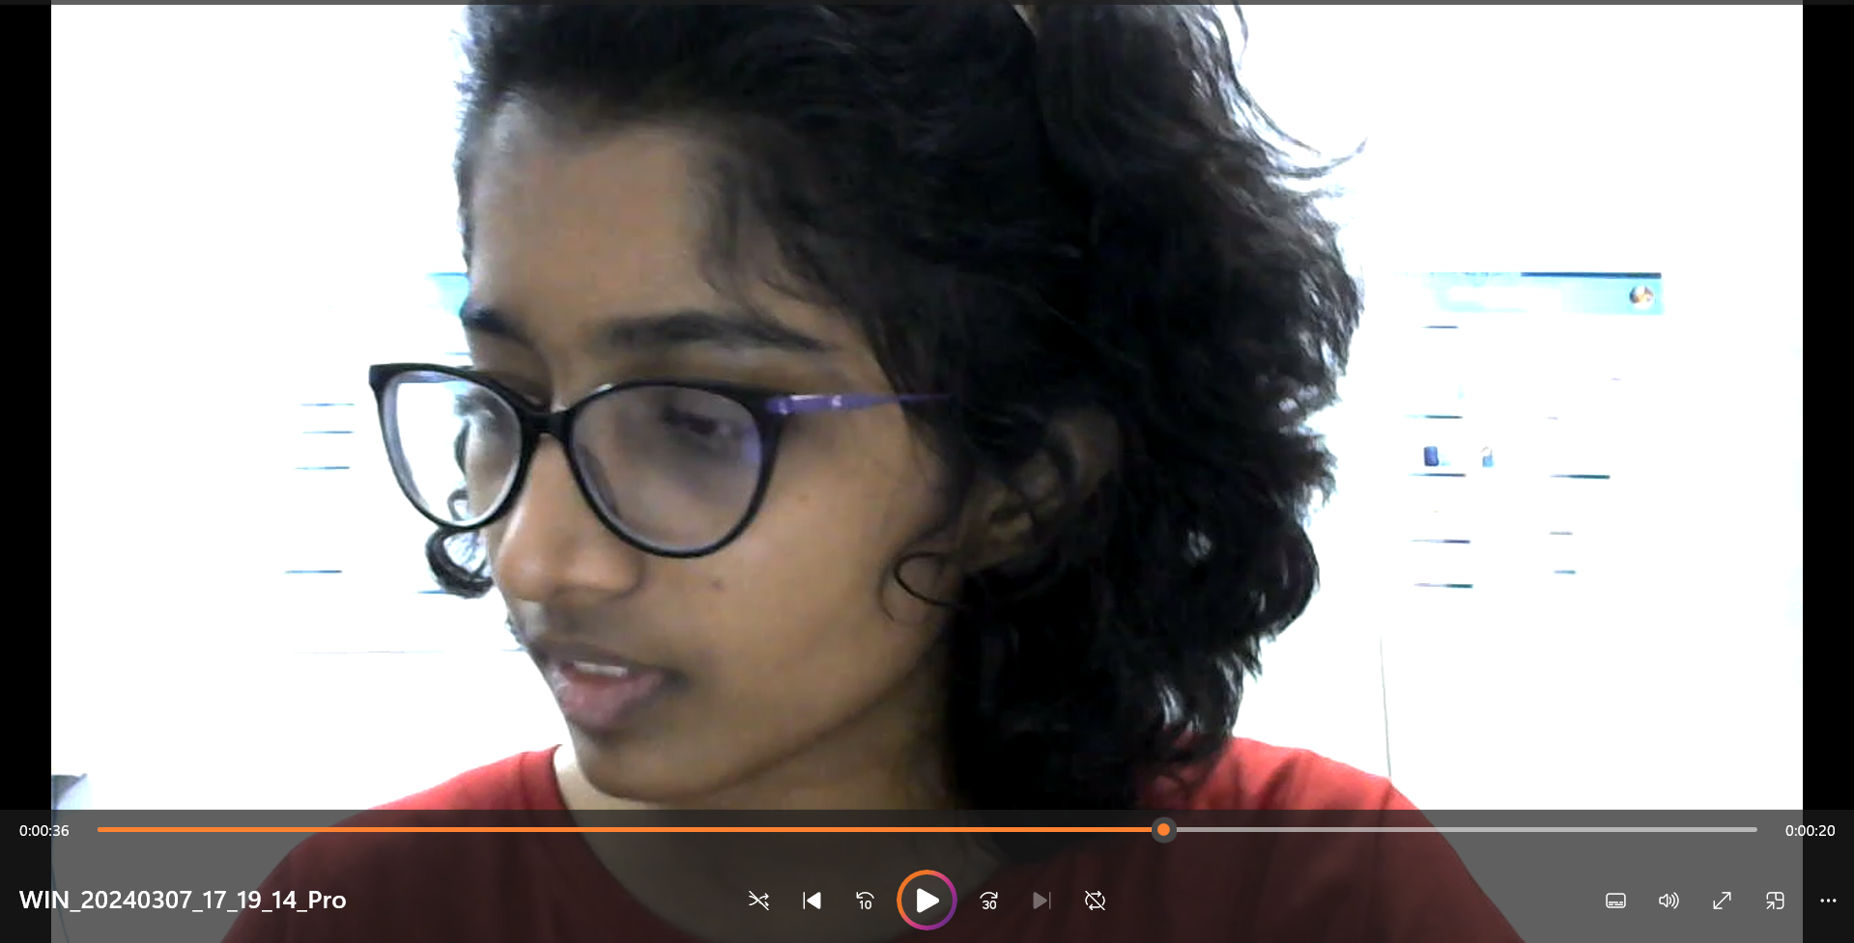
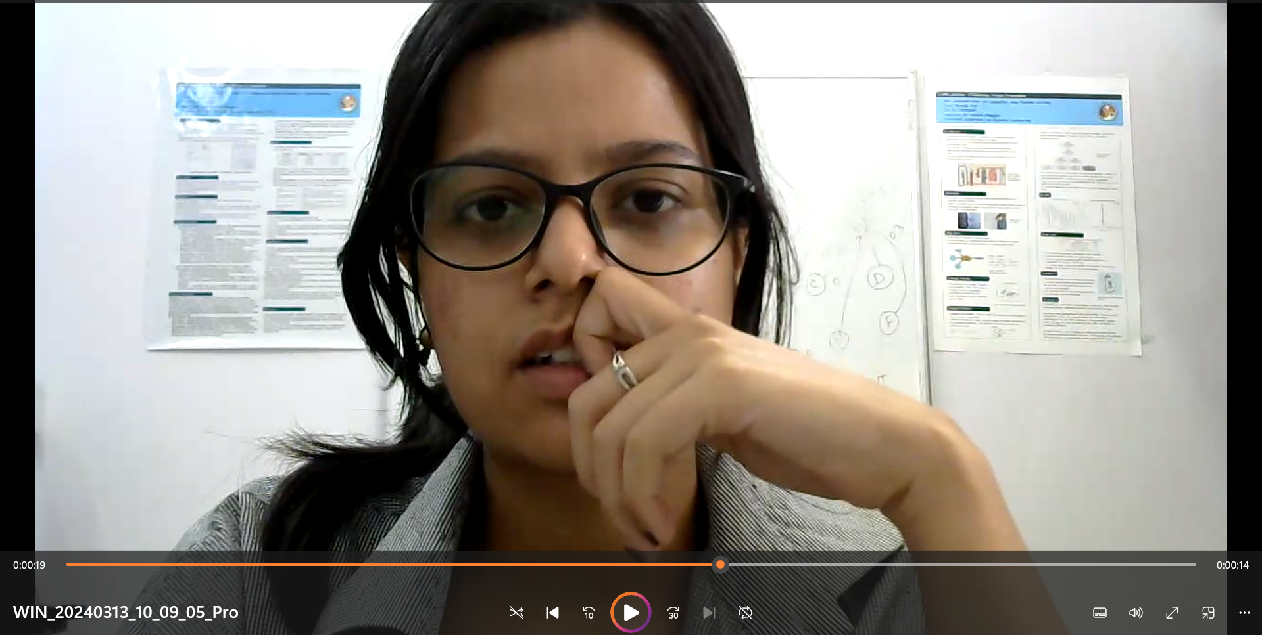
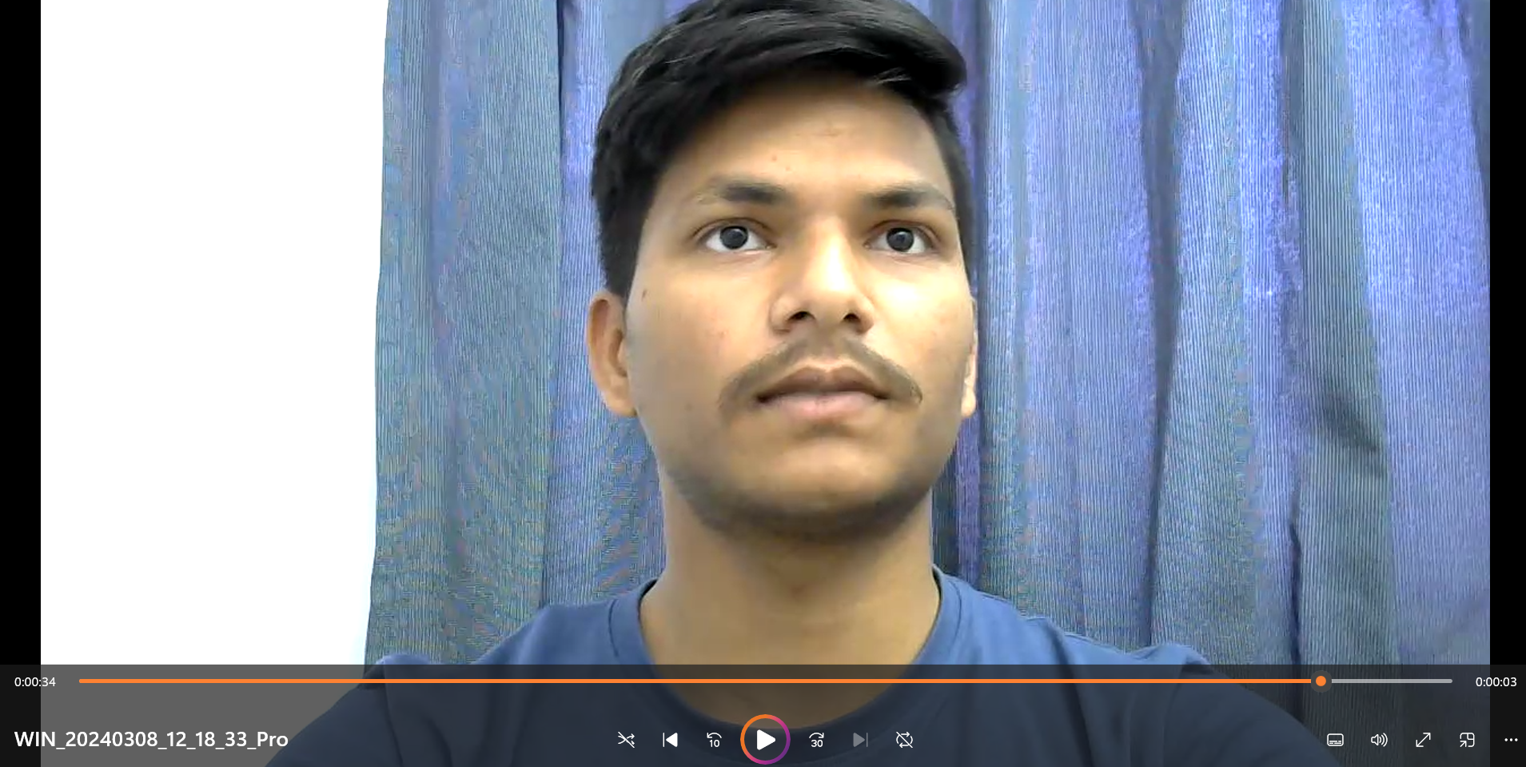
Video Data Collection
Problem Definition
Video data is collected for two scenarios, each lasting for 30 seconds.
Prior Art
Case 1: Maintaining Integrity
Case 2: Allowing malpractice
Impersonation
External Assistance
Data Collection
Overall Architecture
Conclusion
Limitations and Future Scope
Yeturi Venkatesh, 224102324

Slide 19
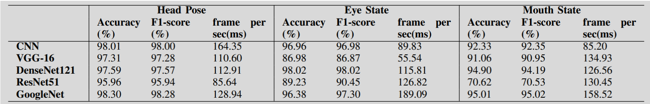
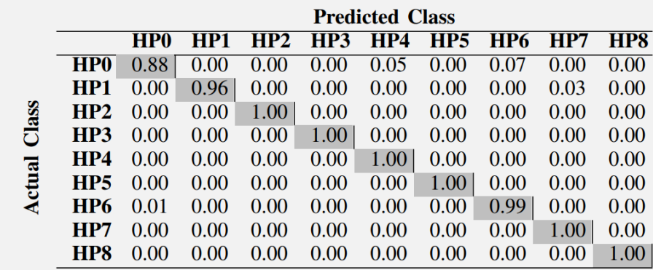
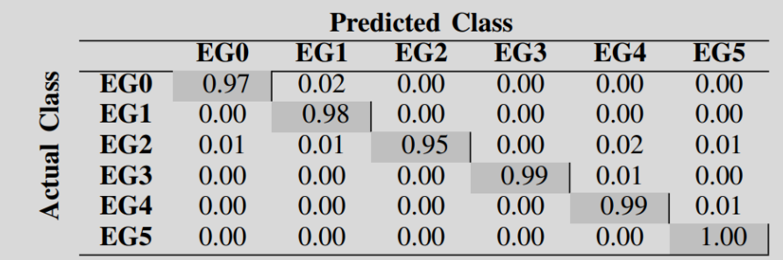
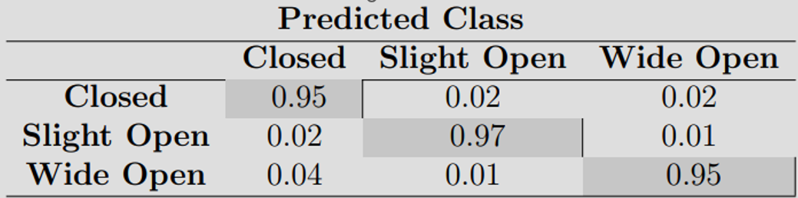
External Assitance - Results
Problem Definition
Prior Art
Impersonation
Fig: Accuracy scores obtained by different deep learning models for classification of head pose, eye gaze and mouth state
External Assistance
Data Collection
Overall Architecture
Actual Class
Conclusion
Fig: Confusion matrices for head pose, eye gaze, and mouth state classification
HP – Head pose, EG – Eye gaze
Limitations and Future Scope
Yeturi Venkatesh, 224102324

Slide 20
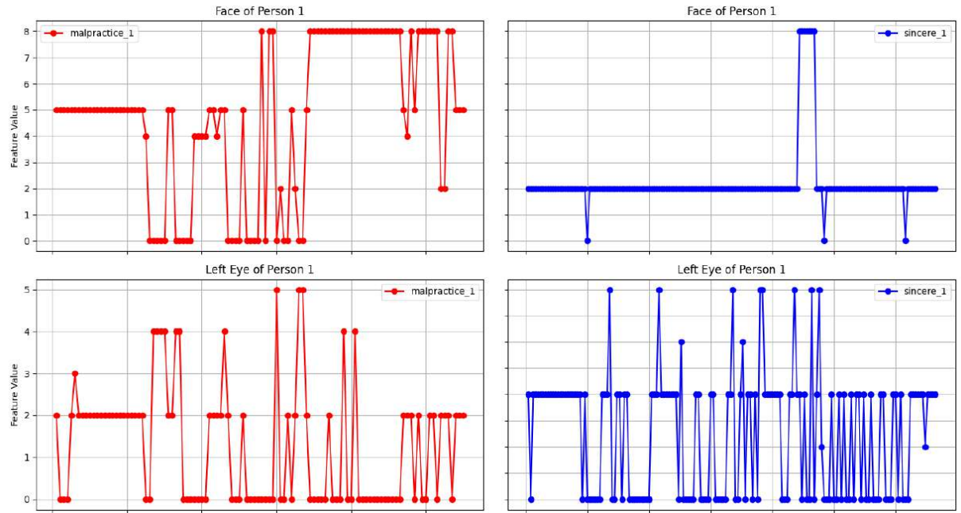
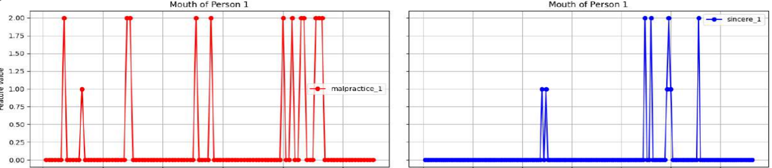
Capturing Temporal Variations - LSTM
Problem Definition
Sequences of head pose, eye gaze, and mouth state are formed from the sequence of frames of video.
Prior Art
Impersonation
External Assistance
Data Collection
Overall Architecture
Conclusion
Limitations and Future Scope
Fig: Comparison of variations in head pose and mouth state of malpractice and sincere cases
Yeturi Venkatesh, 224102324

Slide 21
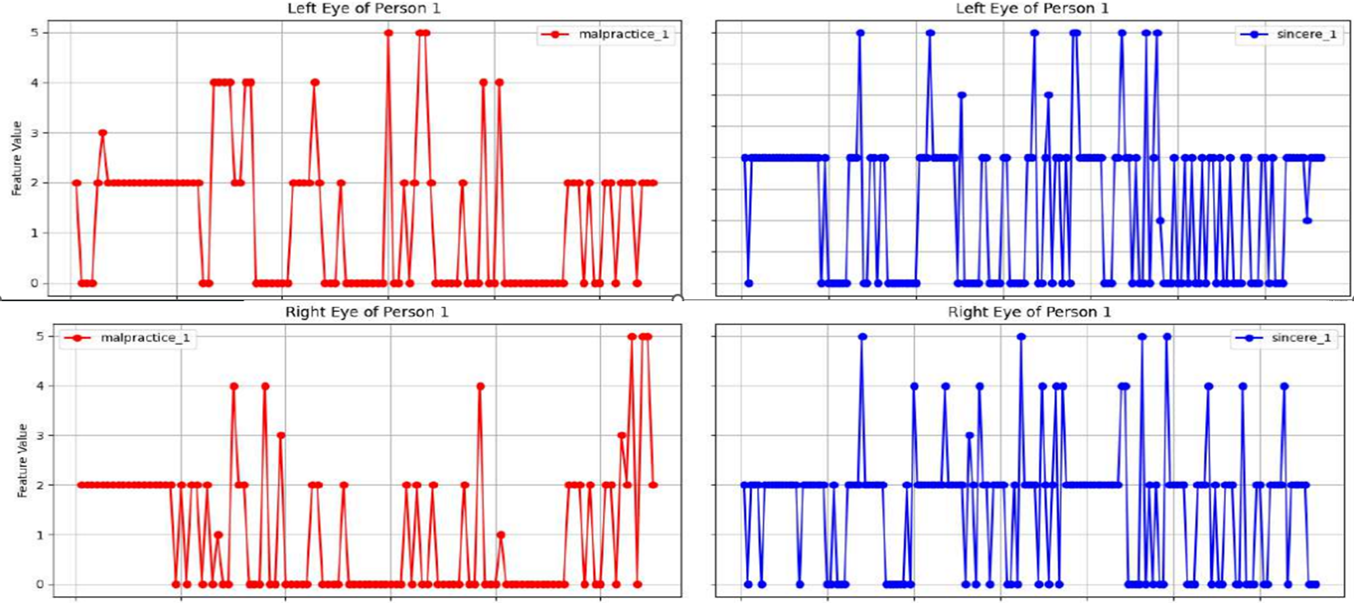
Capturing Temporal Variations - LSTM
Problem Definition
Sequences of head pose, eye gaze, and mouth state are formed from the sequence of frames of video.
Prior Art
Impersonation
External Assistance
Data Collection
Overall Architecture
Conclusion
Limitations and Future Scope
Fig: Comparison of variations in left eye and right eye gazes of malpractice and sincere cases
Yeturi Venkatesh, 224102324

Slide 22
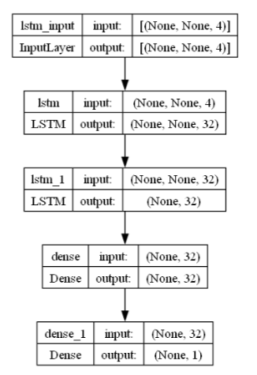
Architecture - LSTM
Problem Definition
LSTM is used to capture the temporal information among the sequences obtained and thus to detect the malpractice.
Prior Art
Impersonation
External Assistance
Data Collection
Overall Architecture
Conclusion
Fig: Architecture of the LSTM network developed
Limitations and Future Scope
Yeturi Venkatesh, 224102324

Slide 23
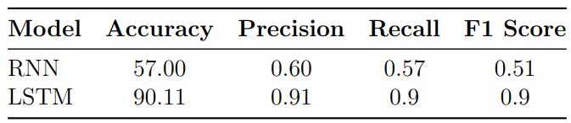
LSTM Network- Results
Problem Definition
RNN (Recurrent neural network) can be used to analyze temporal information.
Limitation: Could not effectively capture long-range dependencies.
LSTM (Long Short Term Memory) shows robust capabilities in capturing long-range dependencies
Prior Art
Impersonation
External Assistance
Data Collection
Overall Architecture
Conclusion
Comparison of results obtained by RNN and LSTM layers in the network
Limitations and Future Scope
Yeturi Venkatesh, 224102324

Slide 24
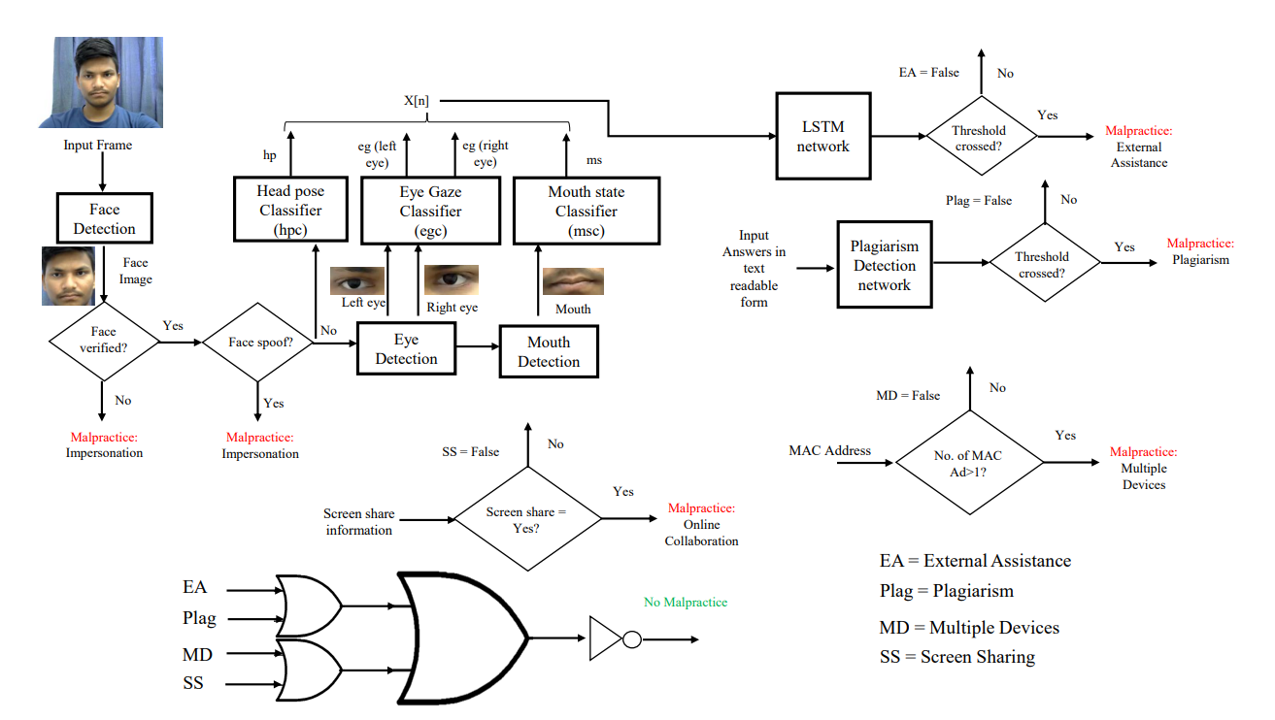
Overall Architecture
Problem Definition
Prior Art
Impersonation
External Assistance
Data Collection
Overall Architecture
Conclusion
Limitations and Future Scope
Yeturi Venkatesh, 224102324

Slide 25
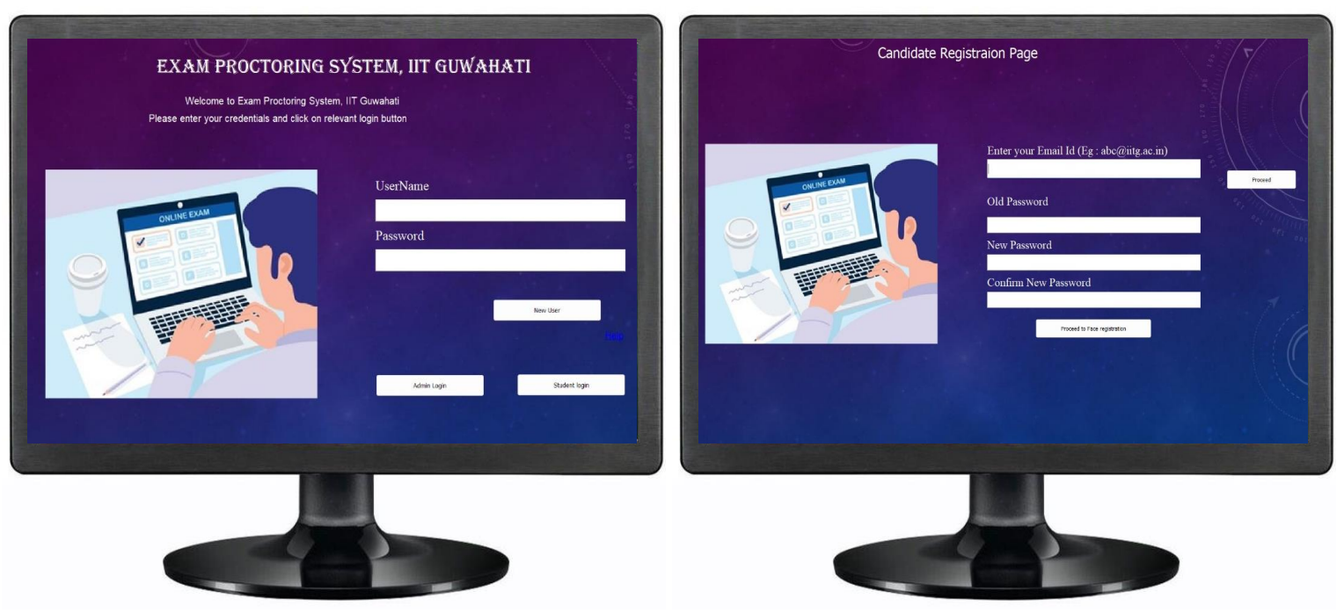
Implementation
Problem Definition
Developed front-end GUI using PyQt6 tool utilizing the local database for storing students’ data.
Prior Art
Impersonation
External Assistance
Data Collection
Overall Architecture
Conclusion
Fig: Webpages showing login and registration forms of the software
Limitations and Future Scope
Yeturi Venkatesh, 224102324
Notes:
Used PyQt6 to implement graphical user interface

Slide 26
Conclusion
Problem Definition
Prior Art
Developed an end-to-end algorithm to detect malpractice in online exams
Formed a database of complete student data, implementing stringent security measures
Implemented a face liveliness detection feature in impersonation detection
Utilizing various pre-trained models, developed a set of robust deep-learning frameworks for classification
Impersonation
External Assistance
Data Collection
Overall Architecture
Conclusion
Limitations and Future Scope
Yeturi Venkatesh, 224102324

Slide 27
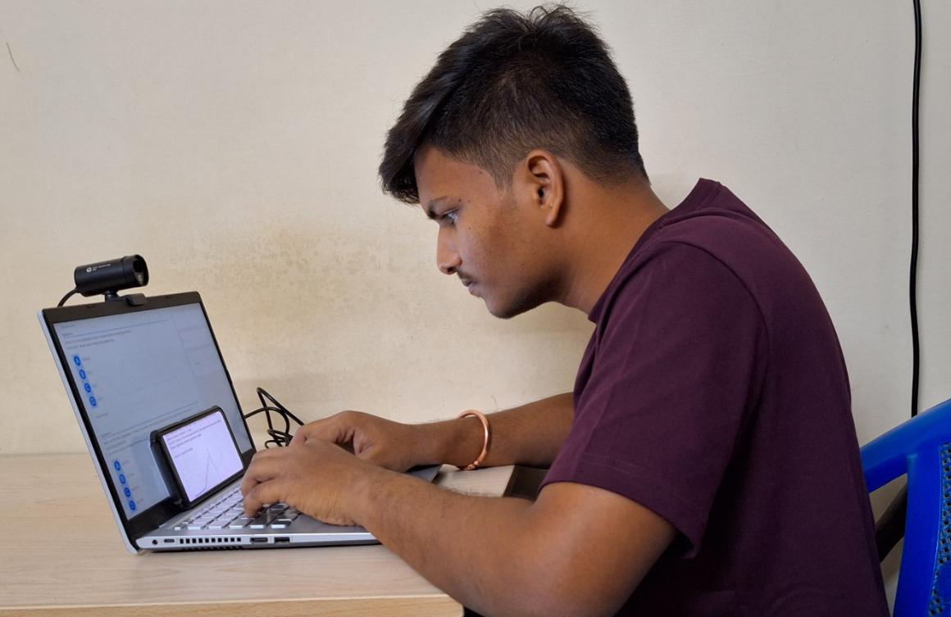
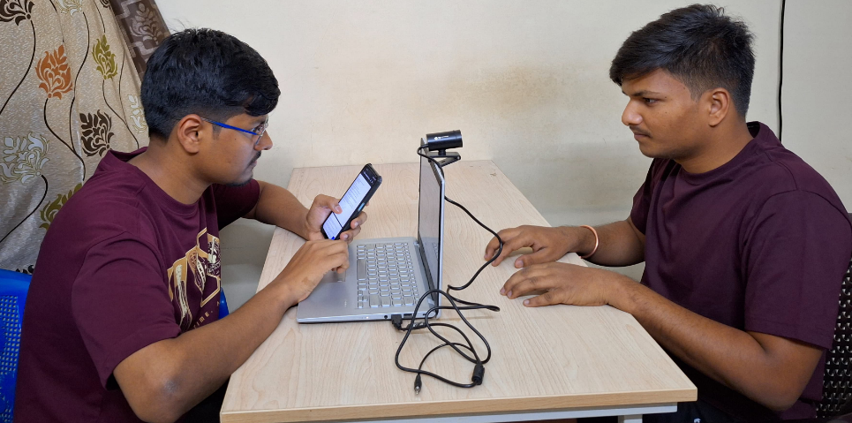
Limitations and Future work
Problem Definition
Prior Art
Impersonation
External Assistance
Data Collection
Overall Architecture
Fig: Strategically placing a mobile device in front of the exam screen to minimize eye movement variation, thus deceiving the monitoring camera.
Fig: Positioning the genuine candidate behind the laptop with the camera angled away, creating the illusion that they are facing the screen, while the proxy sits in front of the screen.
Conclusion
Limitations and Future Scope
Yeturi Venkatesh, 224102324

Slide 28
Research Publications
Prior Art
Impersonation
External Assitance
We have submitted our research manuscript titled” A Comprehensive Multimodal Approach for Detecting Malpractice in Online Exams” to IEEE Transactions on Education for consideration.
Date of submission: April 30, 2024
Data Collection
Overall Architecture
Conclusion
Limitations and Future Scope
Research Publications
Yeturi Venkatesh, 224102324

Slide 29
References
Prior Art
Impersonation
[1] C. S. Indi, V. Pritham, V. Acharya, and K. Prakasha, “Detection of malpractice in e-exams by head pose and gaze estimation,” International Journal of Emerging Technologies in Learning (Online), vol. 16, no. 8, p. 47, 2021.
[2] K. Nataraj, D. Xavier, T. Vishrutha, S. Kavya, and M. Hemalatha, “Malpractice detection system for online examination using ai,” in International Conference on Data Science, Machine Learning and Applications. Springer, 2022, pp. 381–389
[3] D. Kangane, S. Pappu, V. Shah, and N. Shaikh, “Problems & malpractices during online exams with possible solutions,” 2021.
[4] L. Wei, Z. Cong, and Y. Zhiwei, “Fingerprint based identity authentication for online examination system,” in 2010 Second International Workshop on Education Technology and Computer Science, vol. 3, 2010, pp. 307–310.
External Assitance
Data Collection
Overall Architecture
Conclusion
Limitations and Future Scope
Research Publications
Yeturi Venkatesh, 224102324

Slide 30
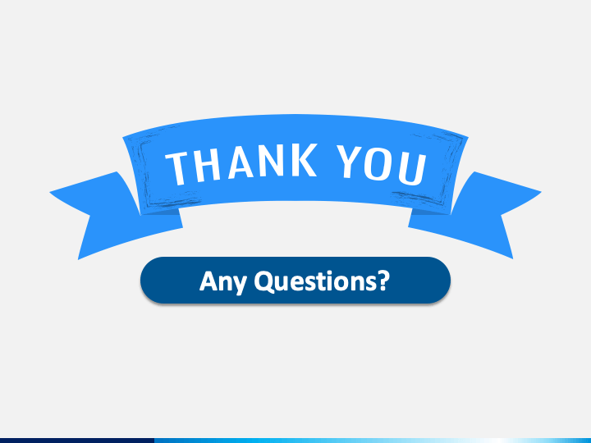

Slide 31
Siamese network: a n/w which is used to find similarities/ differences between two inputs. This n/w is a combination of two similar networks with the same parameters but different inputs
Precision: Measures the accuracy of positive predictions
Recall: Measures the completeness of positive predictions
F1 score: The harmonic mean of precision and recall, which gives equal weight to both metrics – to get a comprehensive understanding of model’s performance
Haar cascade is an algorithm to detect objects – used edge/ line detection features
Pooing: Process of reducing spatial dimensions of feature maps while preserving important information
RNN – short term dependencies, LSTM – long term dependencies (machine translation, speech recognition)
VGG16: (13CL+3FL) – first n/w to demonstrate that performance increases with depth – large no.of parameters (138ml)
VGG19: (16+3) – increased performance but may cause overfitting.
ResNet50: Deep residual network with 50 layers and residual blocks with skip connections – mitigating vanishing gradient problem. → computationally very expensive
DenseNet121: concatenates feature maps from preceeding layers – efficient use of parameters – less computations.
InceptionV3: Inception modules – multiple CNN and pooling layers run in parallel and concatenate their outputs. Caputures multiscale features – manageable computational cost. Scalable. Hardware design difficult.
GoogleNet (InceptionV1): 22 layers – 9 inception modules -

